Slide 1



Introduction to the
Municipality of Tuzi
& the ARTE – Art for Europe Project
Kristjan Gjokaj

Slide 2
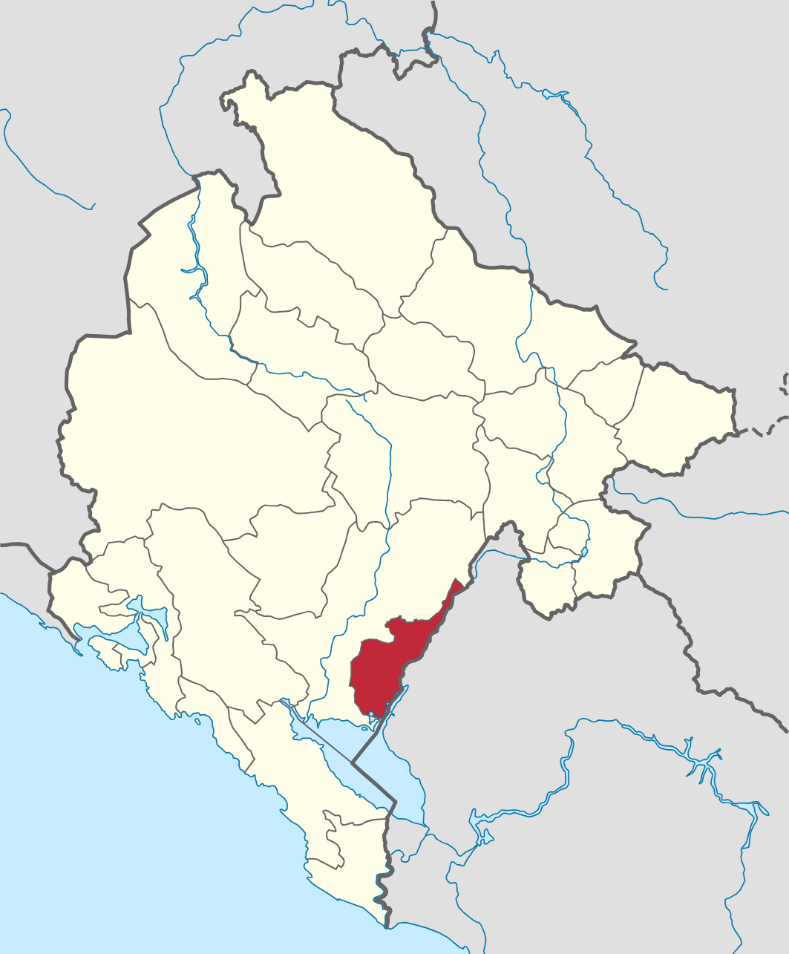
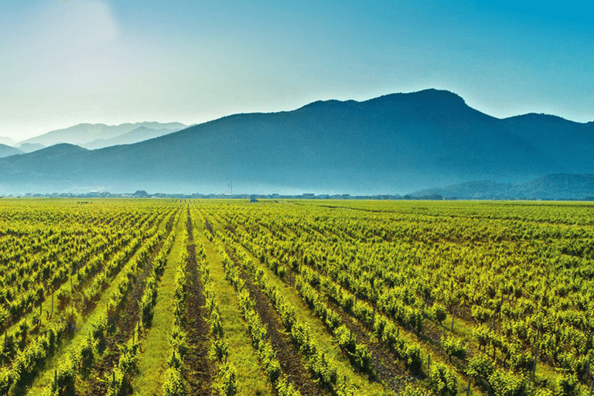
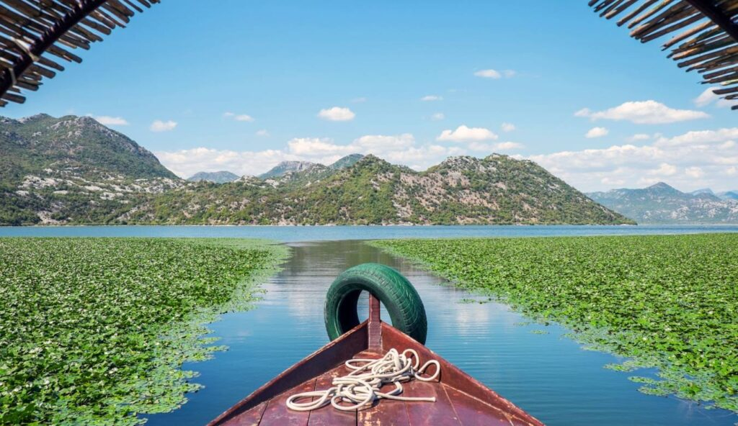
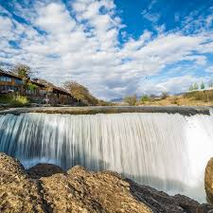
Municipality of Tuzi
Small municipality in southern Montenegro
10 minutes from the capital Podgorica
Around 14,000 inhabitants
Dynamic community with active youth
The largest vineyard in Europe
Lake Skadar
Niagara falls of river Cijevna

Slide 3
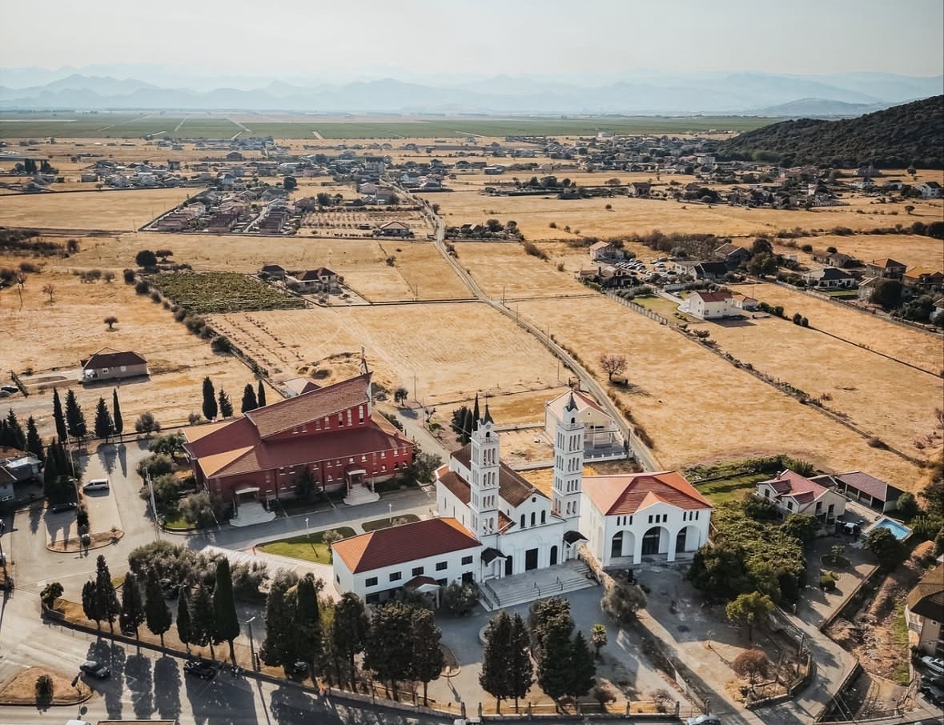
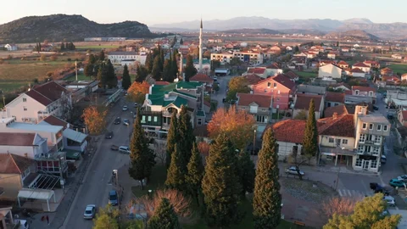
Youth in Tuzi
Active and Engaged Youth
Sports: football, basketball, taekwondo, ballet
Red Cross volunteers
Cultural activities and events
Participation in traditional carnivals
Civic initiatives and community engagement

Slide 4
Youth Policy in Tuzi
Support for Youth Development
Municipality priorities:
Learning opportunities
Youth participation
Personal and professional development
Key instrument: Local Action Plan for Youth

Slide 5
Youth Activities
Trainings and workshops on:
Project development & project writing
CV writing & job interview preparation
Bullying and peer violence prevention
Online safety & cyber violence awareness
Digital skills & digital literacy
Cultural events and concerts
Youth round tables for policymaking participation

Slide 6
Additional Support for Youth
Municipal Support
Annual student scholarships for the best students
Cooperation with local schools
Educational, cultural and social initiatives

Slide 7
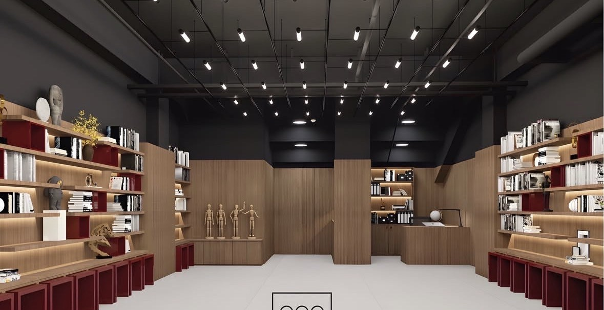
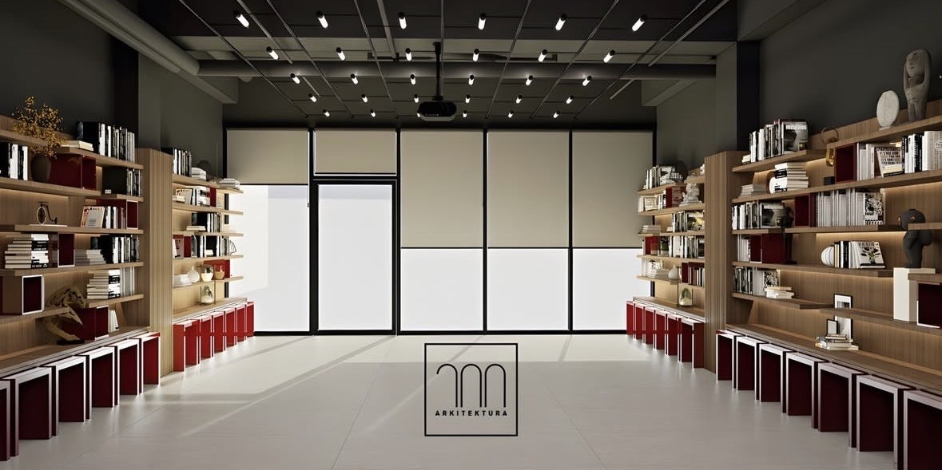
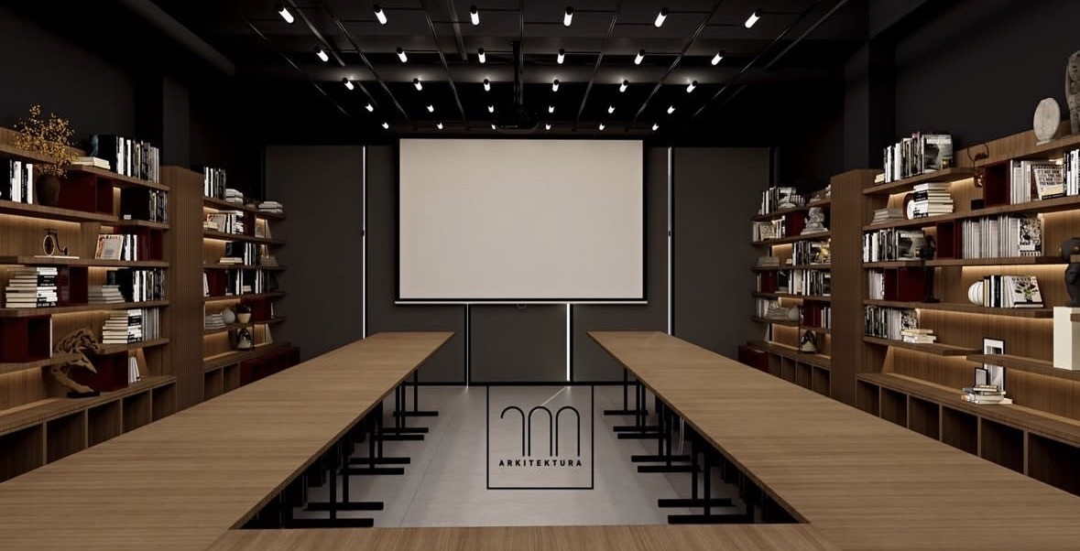
New Youth Center
One of the most modern youth centers in Montenegro
Multifunctional youth space
Activities will include:
Trainings and workshops
Movie nights and cultural events
Library and study spaces
Youth meetings and project development

Slide 8
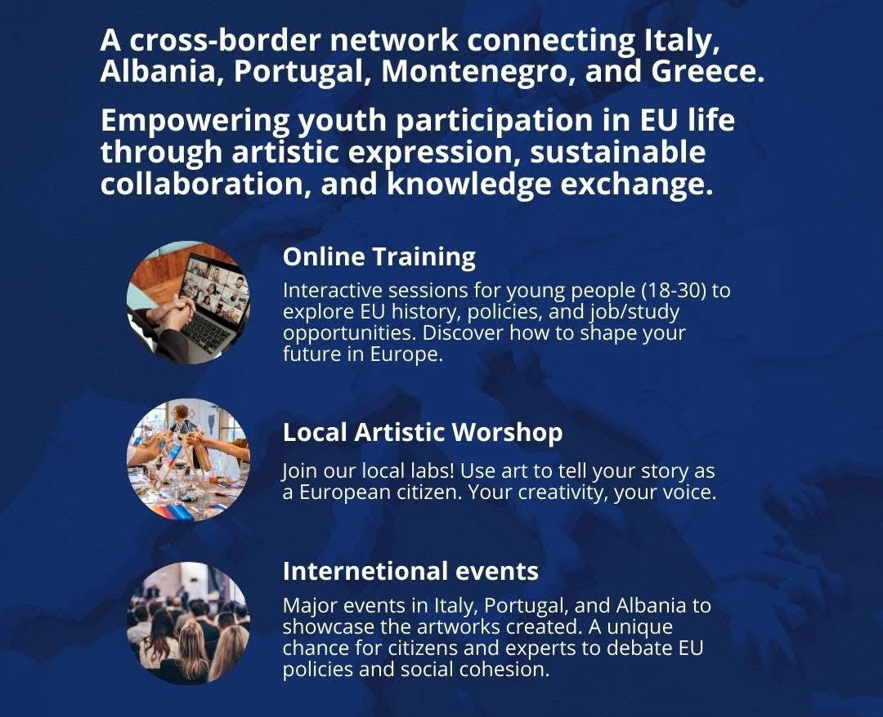
ARTE – Art for Europe
EU Project – CERV Programme
Youth aged 18–30
5 partner countries
Focus on creativity, participation and European values
First EU-funded youth project for the Municipality of Tuzi.

Slide 9




Project Partners
1
ESCOOP – Italy (Lead Partner)
Municipality of Tuzi – Montenegro
DESINCOOP – Portugal
ARSIS – Greece
Municipality of Shkoder – Albania
2
3
4
5

Slide 10



3 Phases of the ARTE Project
WP1 (Work Package 1)
Online trainings
WP2 (Work Package 2)
Local workshops
WP3 (Work Package 3)
International events

Slide 11
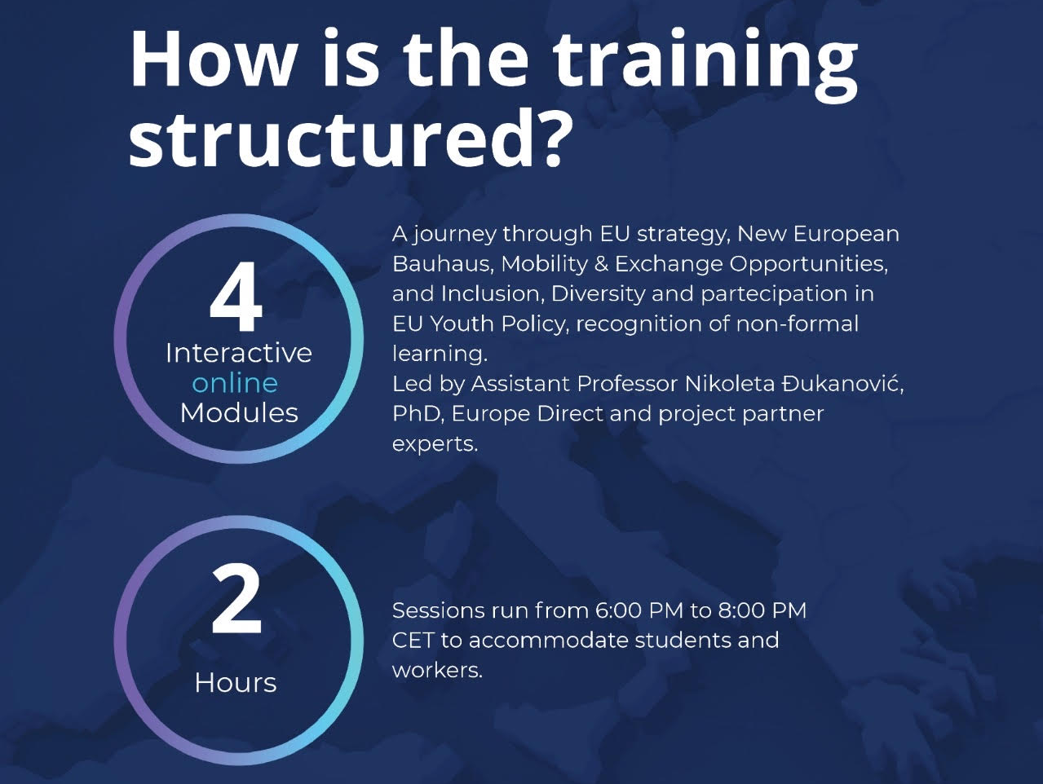
Topics include:
EU institutions and policies
Opportunities for study, work and travel
Youth programmes and initiatives
Volunteering and mobility opportunities
Training groups:
Group 1: February – March
Group 2: March – April
Group 3: May
WP1 (Work Package 1)
Online trainings

Slide 12
12 creative workshops for 12 months:
Painting
Acting
Dance
Photography
Sculpture
Other artistic expressions
Theme: European Union & European values
Participants can share ideas and preferences.
WP2 (Work Package 2)
Local workshops

Slide 13
Study visits to:
Italy
Portugal
Albania
Selected participants will:
Present their work
Represent their community
Meet young people from other countries
WP3 (Work Package 3)
International events

Slide 14

Message to Participants
Stay Active & Involved
Participate in trainings and workshops
Engage in youth organisations and NGOs
Gain new skills and experiences
Use certificates to strengthen your CV

Slide 15
Thank you for your attention!
arte.tuzi@gmail.com
Tuzi, Montenegro
kristjan.gjokaj
https://tuzi.org.me/

